Slide 1
Pulmonary Hypertension
Imaging and invasive measurements for diagnosis and prognostication

Slide 2
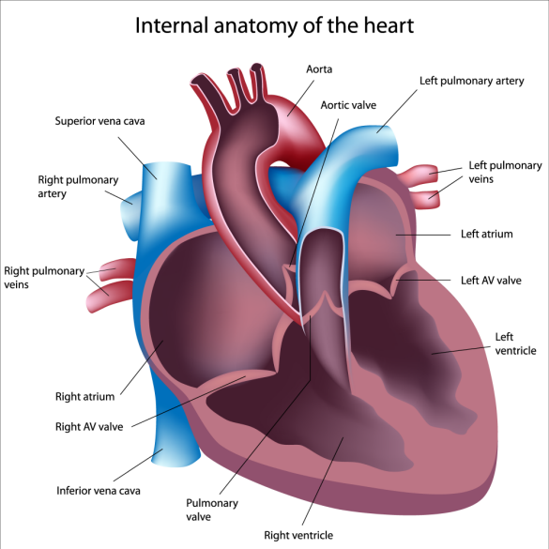

Slide 3
Pulmonary artery hypertension stratified into 5 groups by etiology
Group | Name | Example Etiologies
Group 1 | Pulmonary arterial hypertension | Heritable PAH (75% BMPR2) Drug or toxin PAH PAH 2/2 connective tissue disease, HIV, congenital HD, Schistosomiasis, etc. 1` – “pulmonary venoocclusive disease” 1`` – pers. pHTN of the newborn
Group 2 | PH from left-sided heart disease | HFpEF, HFrEF, valvular heart disease
Group 3 | PH from chronic hypoxic lung disease | Obstructive lung disease Restrictive lung disease Mixed obstructive/restrictive Many others
Group 4 | PH from chronic thromboembolic disease | e.g. APLS, Sickle Cell
Group 5 | Unclear or multifactorial disease | Sarcoidosis, myeloproliferative disorders, metabolic disorders, cancer-related, dialysis, etc.
Notes:
Patients suspected of having pulmonary hypertension (PH) undergo extensive diagnostic testing. The purpose of diagnostic testing is to confirm that PH exists and identify the underlying cause so that appropriate treatment can be administered.
201/2572 PAH cases in the US PAH Biobank

Slide 4
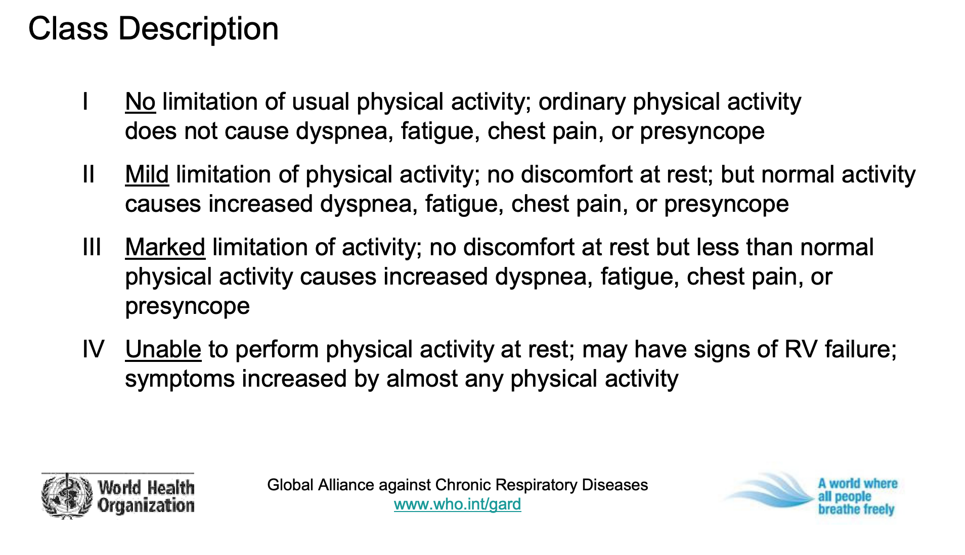
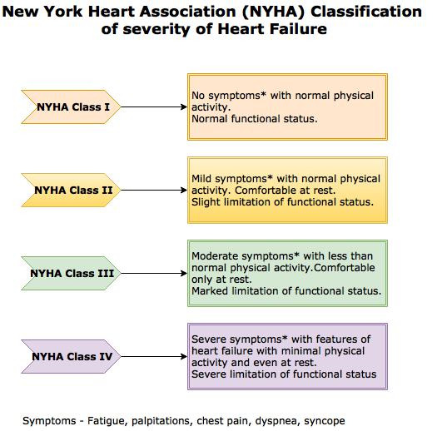
WHO Functional Classification System for PAH
Circa ~2005
Reminds me of…

Slide 5
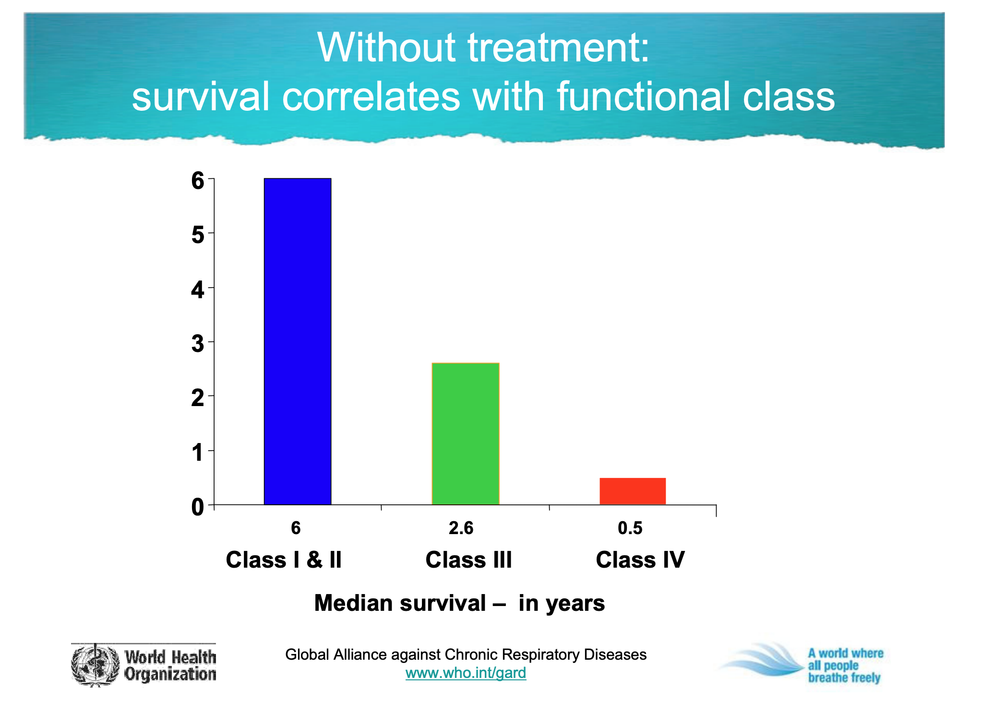

Slide 6
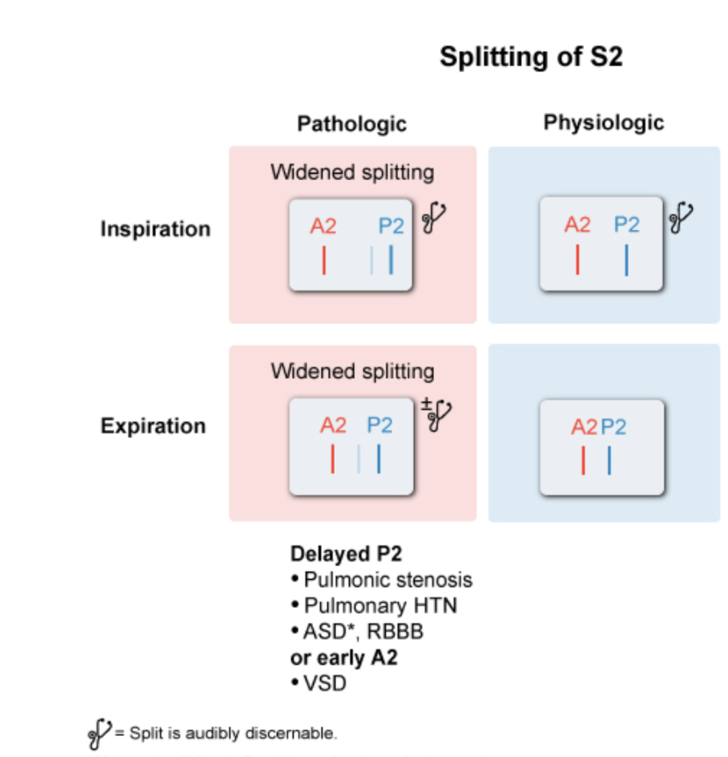
Increased intensity of 2nd heart sound
Second heart sound has widened splitting in setting of RV dysfunction or failure
Splitting normal if RV function is preserved
Unclear sensitivity and specificity, probably highly operator dependent

Slide 7
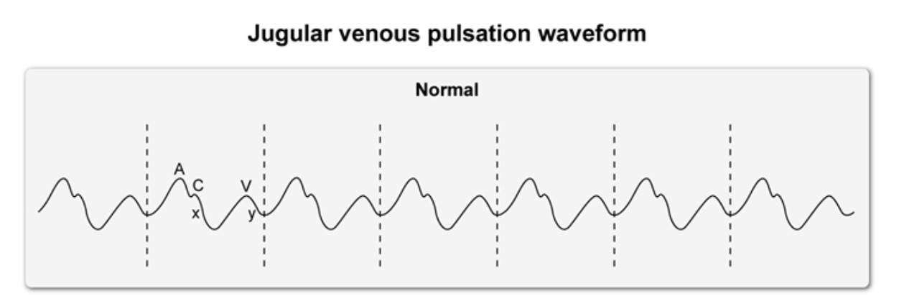
JVP
A waves may be prominent (atrial contraction against overfull RV)
Prominent V wave would indicate tricuspid regurgitation 2/2 severe PAH

Slide 8
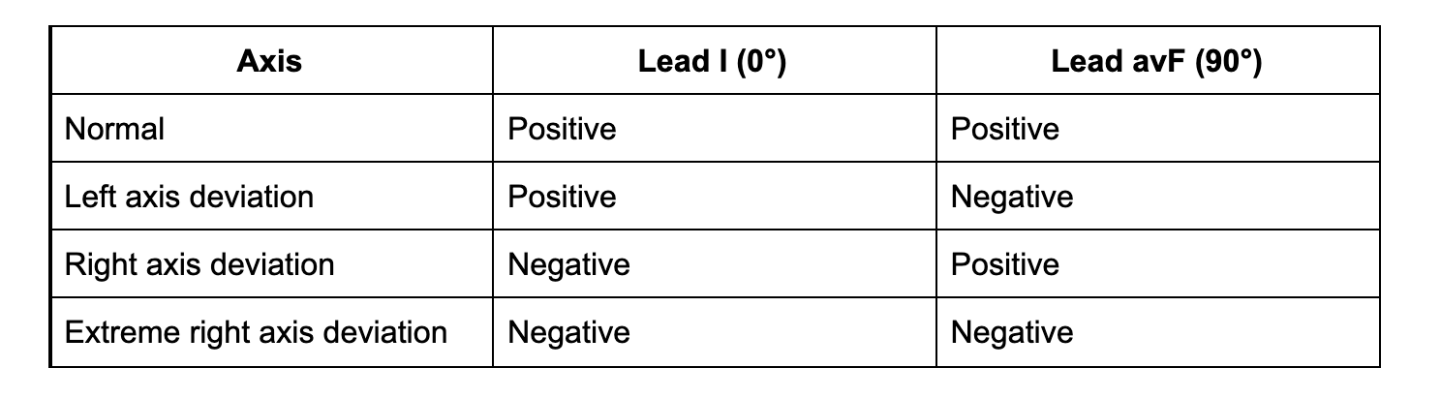
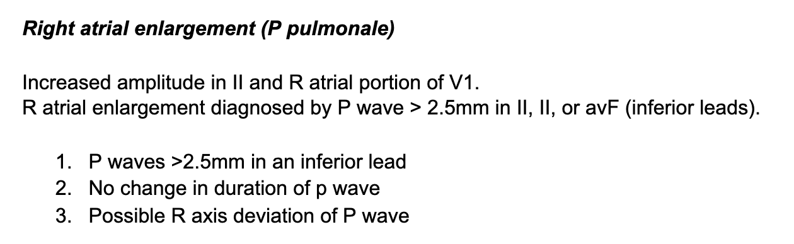
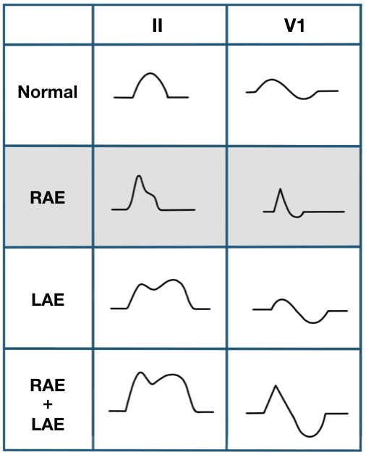
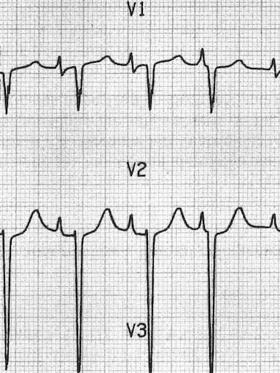
EKG Findings
R axis deviation; R atrium enlargement
Frequently not found in early cases of disease
Low sensitivity overall

Slide 9
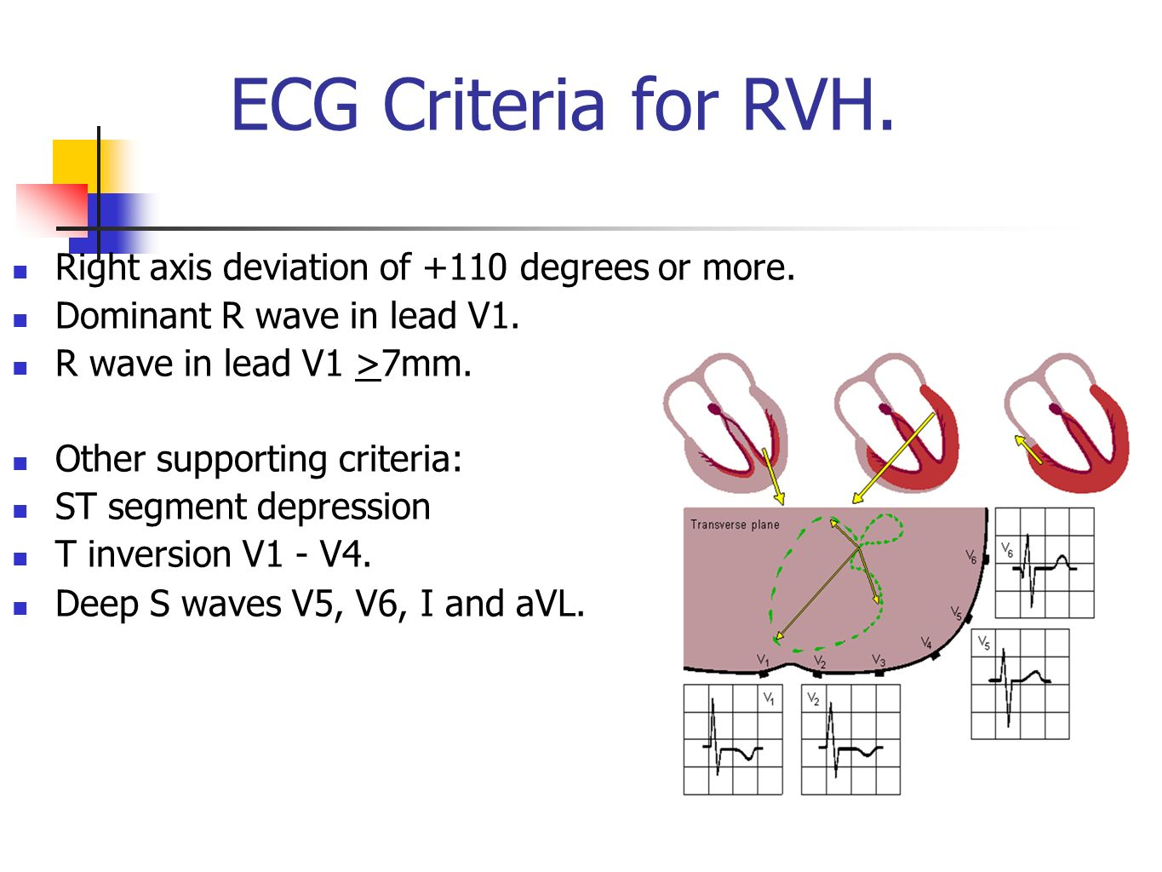
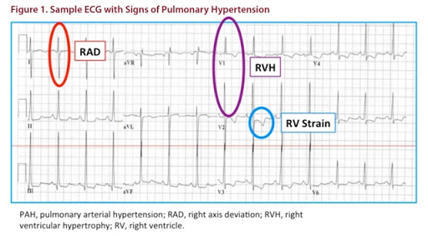
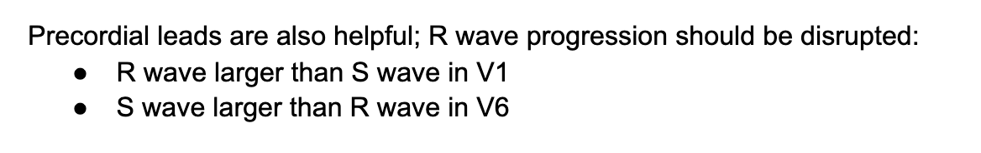
Relatively low sensitivity and specificity

Slide 10
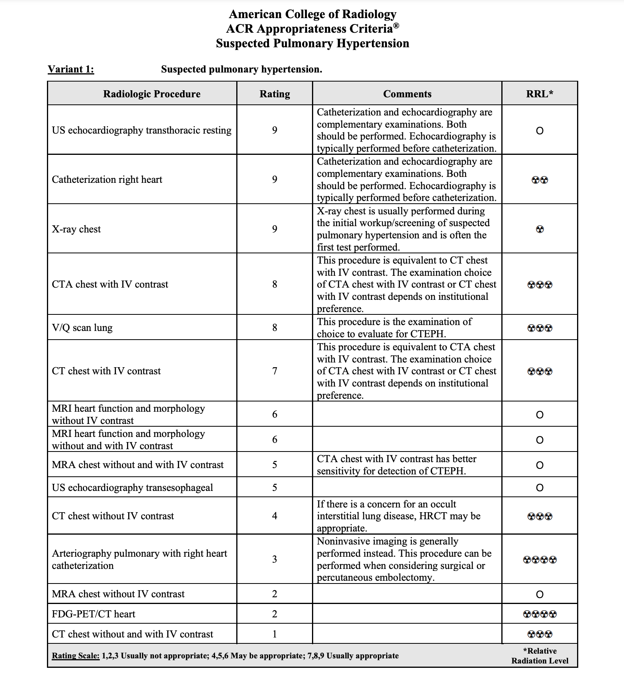
ACR appropriateness criteria for imaging in suspected PH
1-3: Usually not appropriate
4-6: May be appropriate
7-9: Usually appropriate

Slide 11
Pulmonary Hypertension Chest Radiograph

Slide 12
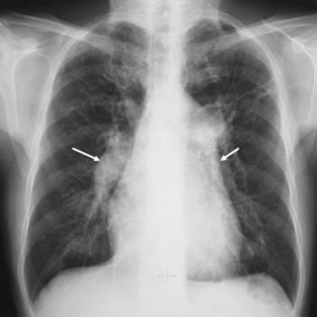
Engorgement/dilation of R and L descending pulmonary arteries

Slide 13
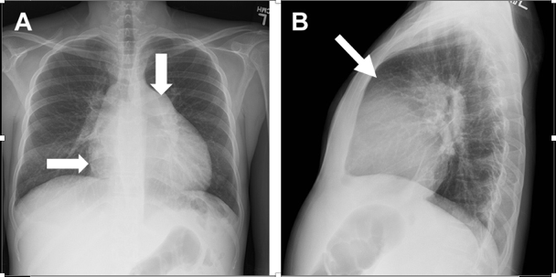
Obliteration of retrosternal space
PA “shadowing”
RA dilation

Slide 14
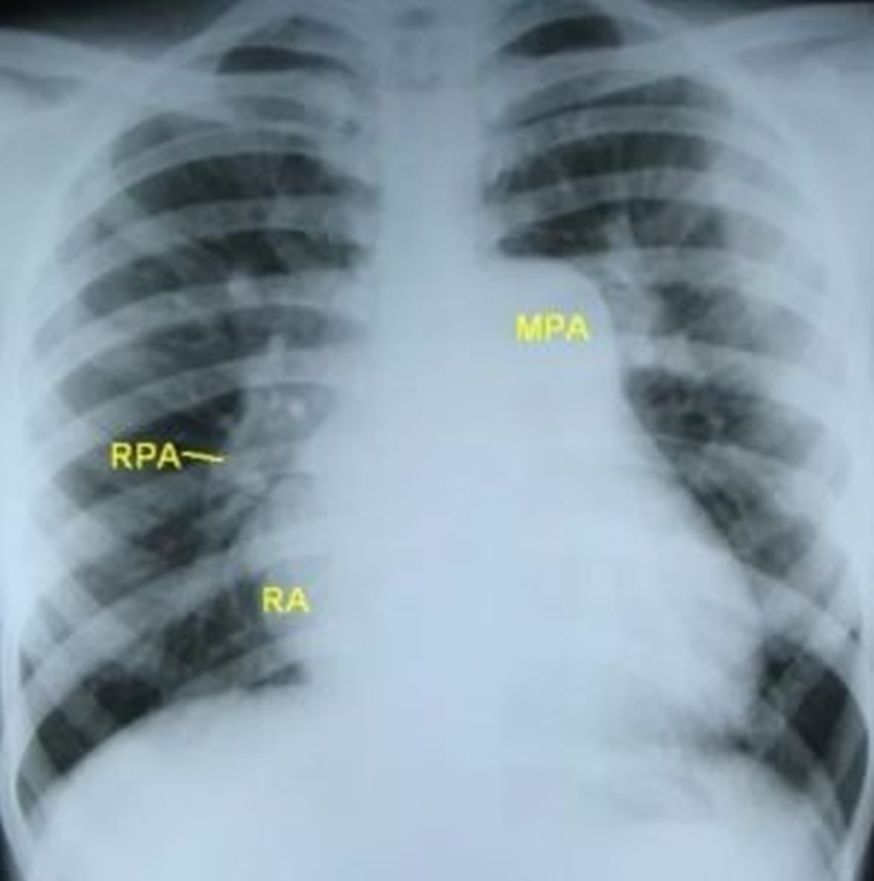

Slide 15
Pulmonary Hypertension Echocardiography
TTE is first choice

Slide 16
TTE in pHTN
TTE is initial test of choice in patients with pHTN
3 major evaluations on TTE:
Tricuspid regurgitant jet velocity (TRJV) --> ePASP
RV size, wall thickness, and function
Assessment for contributing left heart disease

Slide 17
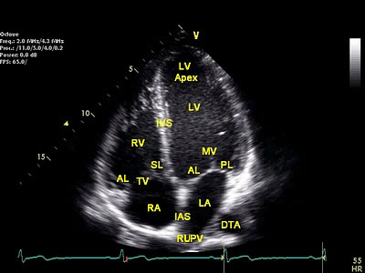
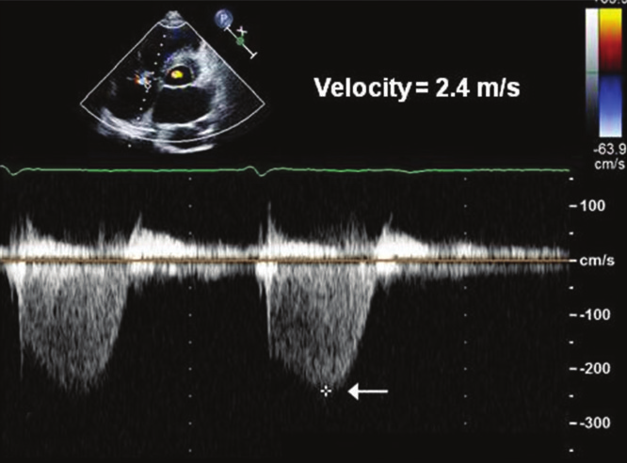
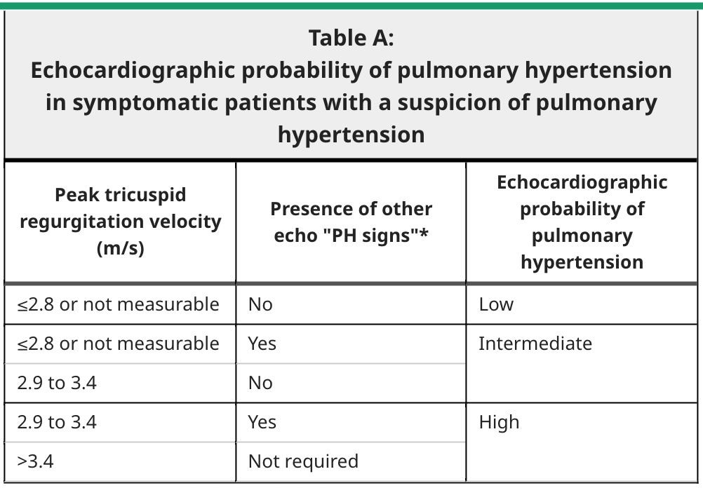
TRJV is estimator for pulmonary artery systolic pressure (ePASP)
ePASP = 4 x TRV² + RAP
ESC 2015
2.8 and 3.4 m/s are numbers to remember
Other echo PH signs: RV/LV diameter > 1.0, flattening of IVS during systole, RV outflow doppler acceleration, early diastolic PA regurgitation >2.2m/s, IVC diameter >21mm without inspiratory collapse, RA ES area >18cm²

Slide 18
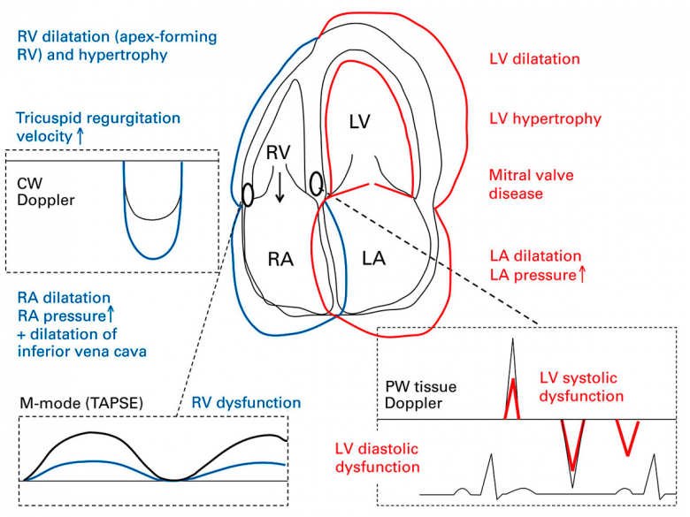

Slide 19
If echo probability of PH is intermediate to high and PH is not explained by left-heart disease: Guidelines recommend performing additional testing to detect underlying etiology.
“Sufficient left heart disease PH” (Group 2) vs. “Insufficient left heart disease PH (1, 3, 4, 5)
i.e., is the PH explainable by left heart disease, or do we need to find another explanation

Slide 20
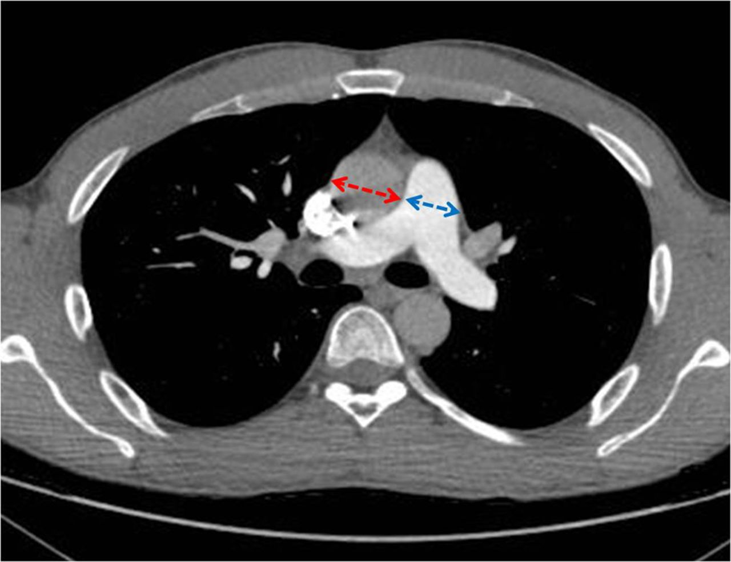
Suspected Group 3 PH (Chronic Hypoxic Lung Disease)
Example testing modalities:
High-resolution CT
DLCO
Pulmonary spirometry
Cardiopulmonary exercise testing
Sleep studies (OSA)

Slide 21
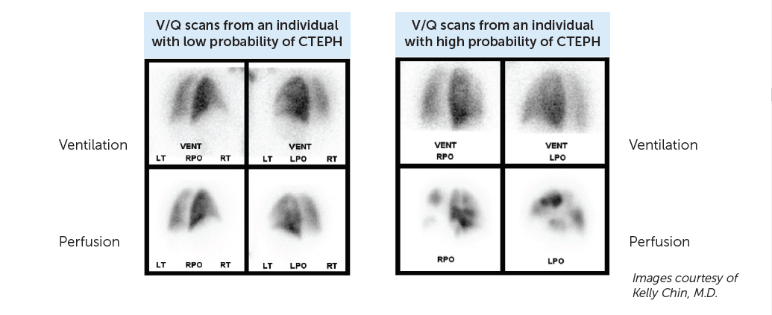
Suspected Group 4 PH (CTEPH)
V/Q scan
High sensitivity (~95%) and specificity (90%) for CTEPH
Can do CTPA or MRPA as well

Slide 22
Right Heart Catheterization (RHC)
“Gold standard”

Slide 23
Why is RHC the gold standard?

Slide 24
ePASP PPV around 25% for pHTN diagnosis
Many similar studies
r² = 0.42

Slide 25
Evaluation for Group 1 and 5 PH
Diagnostic RHC should be performed after groups 2, 3, and 4 are ruled out, or in cases of diagnostic uncertainty
Example diagnostic uncertainty scenarios:
Echo PH risk is low probability, but symptoms clinically out of proportion
Echo PH risk is intermediate to high, but unclear left heart contribution
Group 3 PH, but severity of PH not proportional to imaging findings
Suspected mixed etiology
RHC also useful for baseline severity assessment in all groups, vasoreactivity testing, etc.

Slide 26
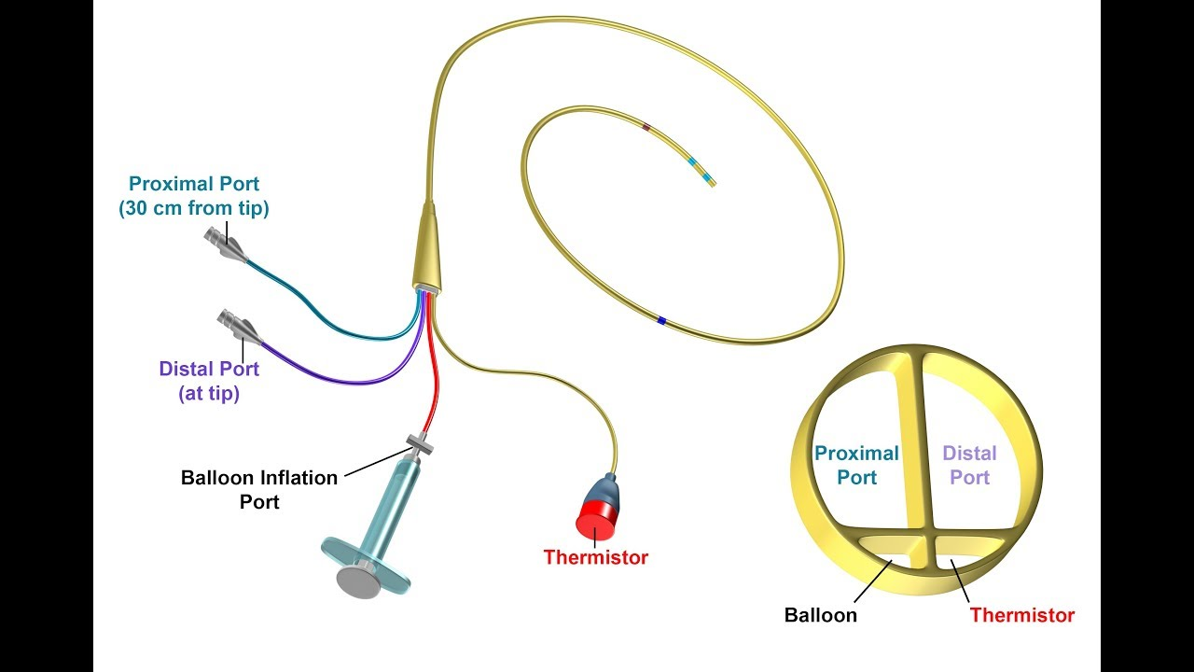
Schwan-Ganz Catheter
Sits in RA
4 major components
Goes through PA
Measures CO
For PCWP
Notes:
Proximal port lies in RA
Terminal portion lies in main PA, thermistor allows determination of CO using thermodulation curve

Slide 27
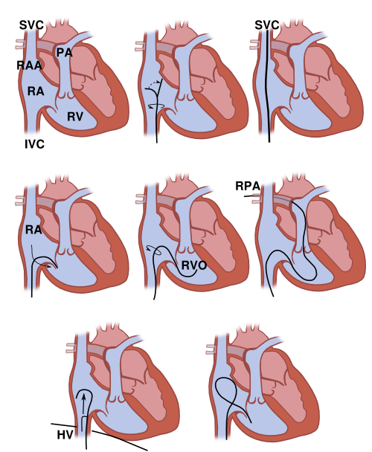
Example Femoral
Approach

Slide 28
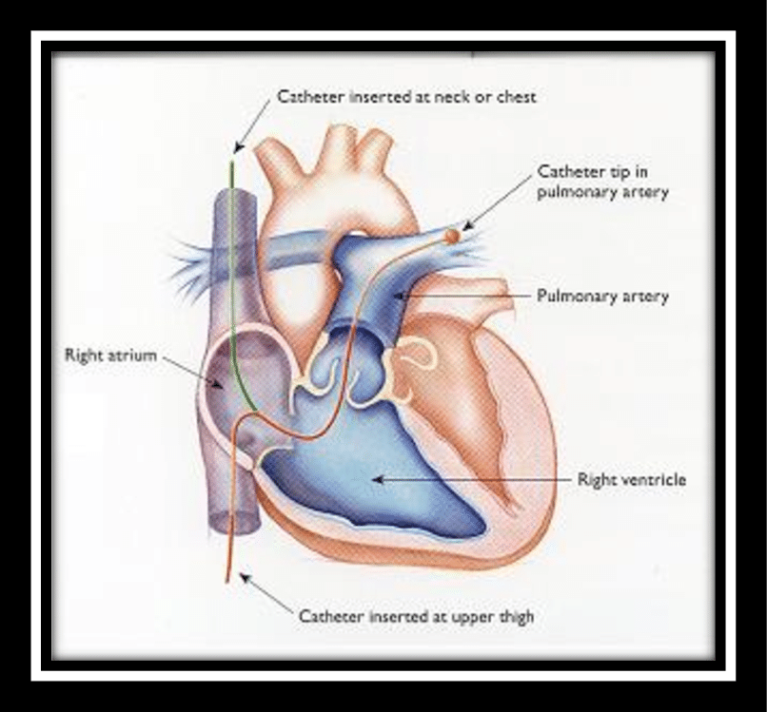
Approach via RIJ more common

Slide 29
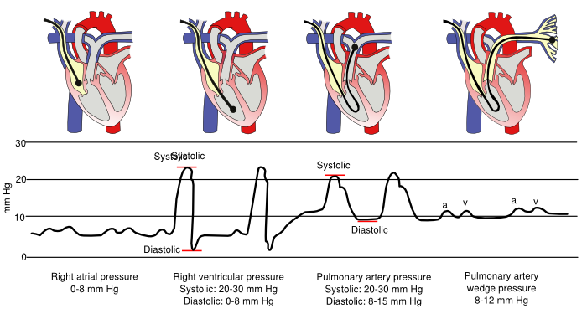

Slide 30
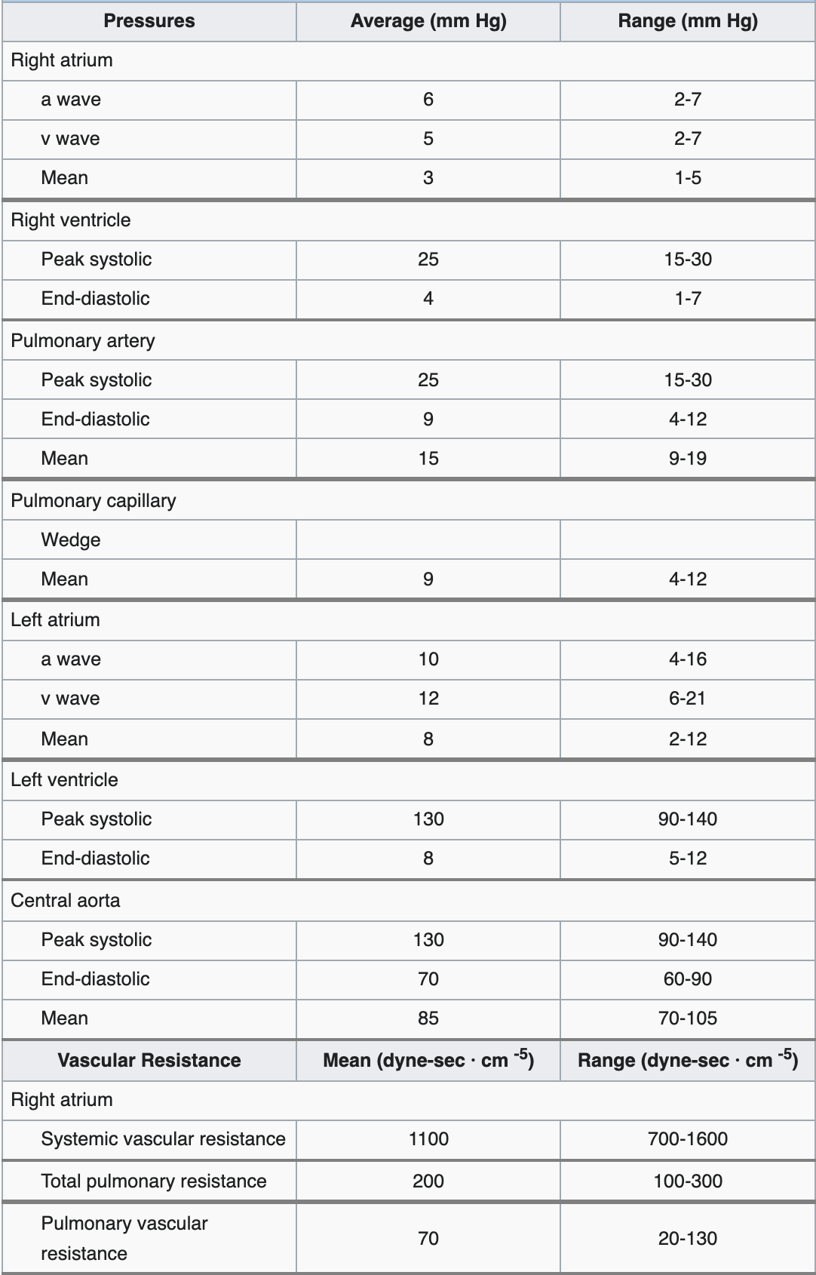
Normal mean PA pressure <20
3 different pressures are essential to PH diagnosis:
Pulm. a. MAP
PAWP (PCWP)
PVR
Normal PAWP < 15
Normal pulmonary vascular resistant <3 woods units
Notes:
Change from past, where PA of 25mmHg was used for PH diagnosis

Slide 31
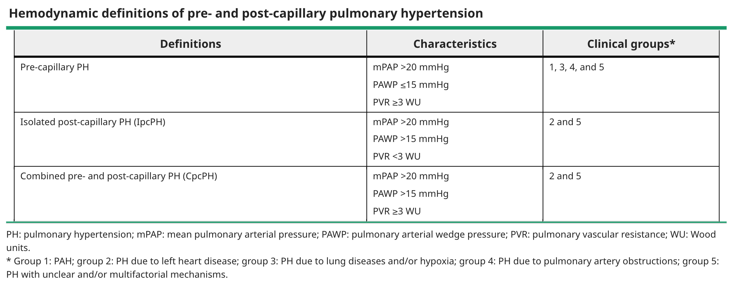

Slide 32
Is PA pressure > 20 mmHg?
Yes
No
This is Pulmonary Hypertension
This is Not Pulmonary Hypertension
Measure PAWP
Is Pulmonary Artery Wedge Pressure ≤15 mmHg?
Yes
No, measure PVR
Is Peripheral Vascular Resistance <3 Woods Units?
Pre-Capillary Pulmonary Hypertension
Yes
No
Combined Pre- and Post- Capillary Pulmonary HTN
Post-Capillary Pulmonary HTN

Slide 33
Questions?

